Slide 1
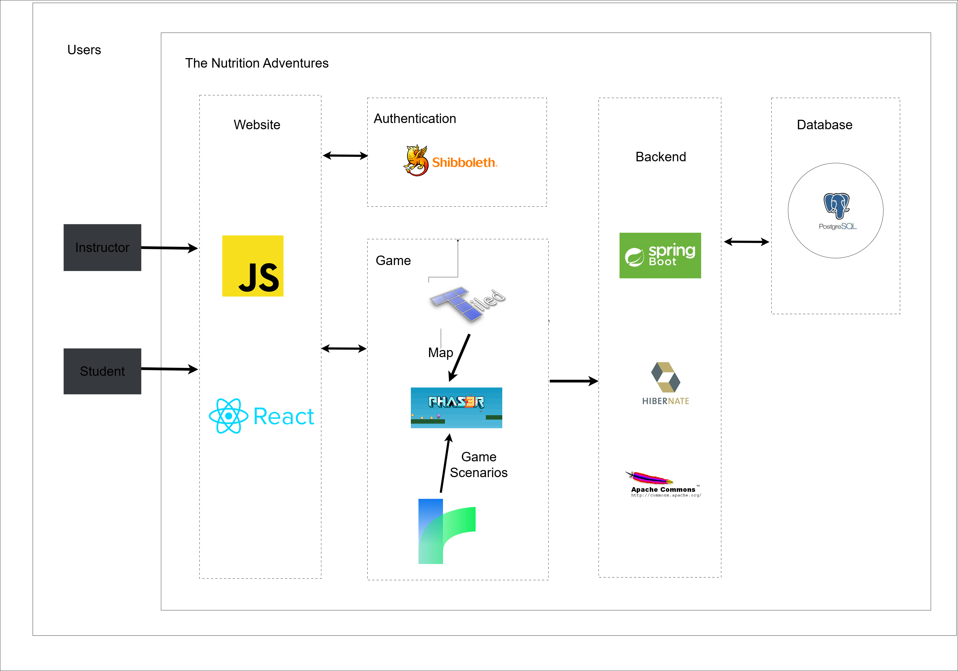
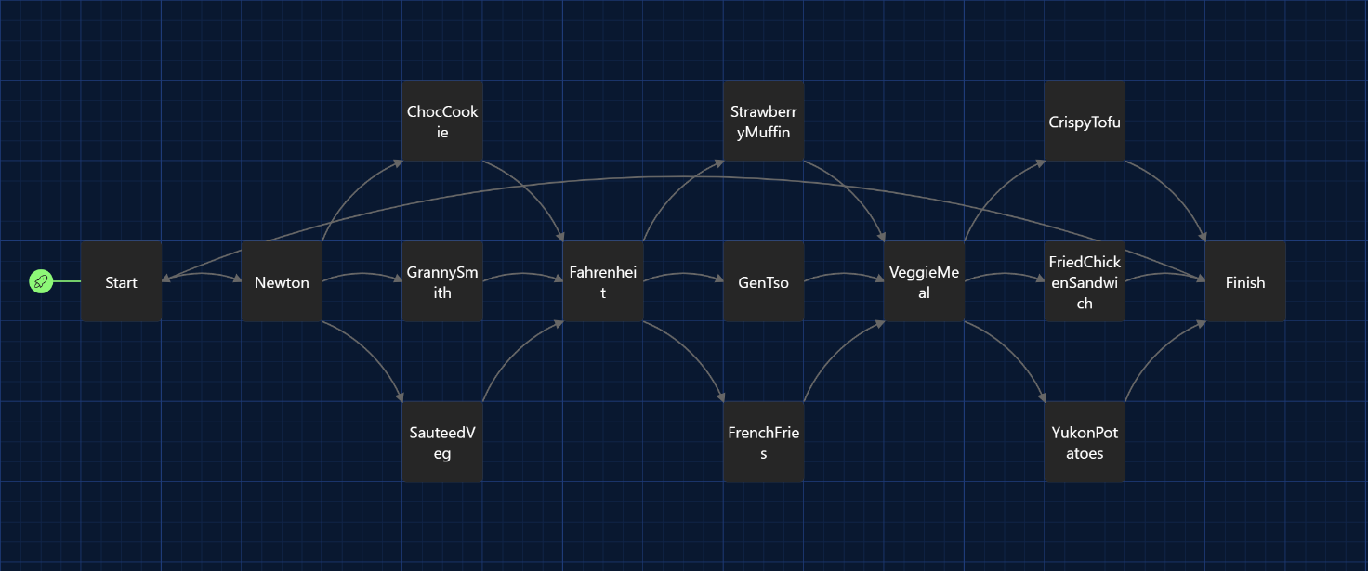
The Nutrition Adventures
[INSERT SPONSOR LOGO]
Moe Ko, Juni Qureshi, Snehanshu Samanta, Matthew Shooman, Alican Sumer
Problem Overview
HIGH LEVEL DESIGN
Sponsor: Dr Renee Harrington, Department of Health and Exercise Studies at NCSU
Problem: Existing nutritional education is unengaging and unrelatable
Goal: Create an educational game that fun and relevant to students
Requirements
Game: Browser-based interactive CYOA game for on-campus dining options
Dashboard: Basic web-app for instructors to track student progress
Security: Integrate Shibboleth authentication for student privacy
Gameplay Loop
TWINE STORY
Testing
INSERT GRAPHIC HERE
(CHANGE IMAGE IN
OPR2 TO SVG)
PUT TEST
COVERAGE HERE

